Slide 1

Year 1 Phonics Screening Check Meeting
Thursday 20th April 2023
Mrs Free and Miss Matthews

Slide 2
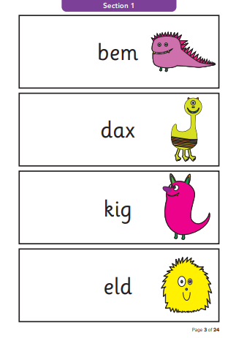
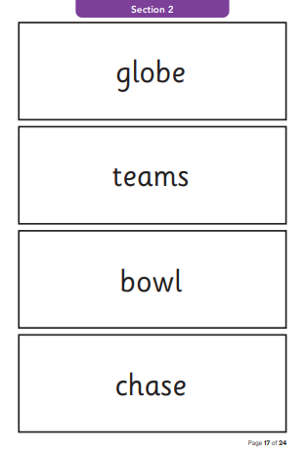
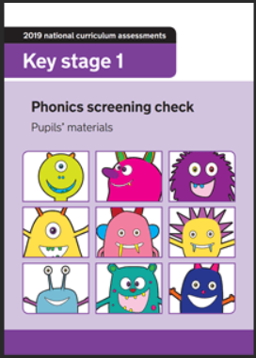
The national phonics screening test was introduced in 2012 to all Year 1 pupils. It is a short, statutory assessment to confirm whether individual pupils have learnt phonic decoding to an appropriate standard. It aims to identify the children who need extra help so that they can be given support to improve their reading skills.

Slide 3
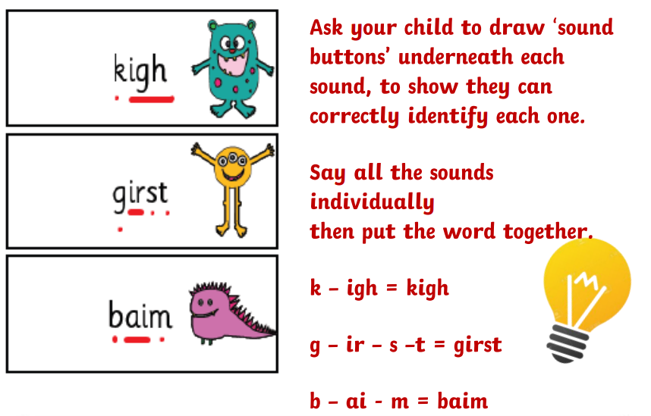
Year 1 Phonics Screening Check
Week beginning 12th June
Children will read 40 words (20 real words and 20 non-words/psuedo words)
Takes approximately 10 minutes to complete
Completed one to one with a teacher
Children are allowed to draw sound buttons to help them decode the words, however the adult administering the assessment is not able to draw these for the child
Children must segment and blend the word independently
Children can revise their attempt at a word; however, adults can not prompt the child to ‘have another go’

Slide 4

Year 1 Phonics Screening Check
Nonsense or non-words check that children will be able to read sounds they know in unfamiliar words
Children who can read nonsense words will, very soon, be able to read any new word
Reading underpins the whole curriculum and daily life.
How many times have you read today?

Slide 5
Year 1 Phonics Screening Check
The pass mark for the assessment will not be released until after the tests have been administered
By the end of the summer term schools must report their child’s results to parents
Schools must also report the results of the screening check to the Local Authority
Results will be shared with you in your child’s end of year report
Children who do not reach the expected level in June will need to retake the test when they are in Year 2

Slide 6
How can I support my child?
Phonics works best when children are given plenty of encouragement and learn to enjoy reading and books. Parents play a very important part in helping with this.
Read with your child daily
Practise the phonics sound cards and word cards, which are sent home by Miss Matthews
Complete the weekly phonics home learning task on Tapestry

Slide 7
Thank you

