Slide 1

Wednesday 6th July 2022
Year 1 Curriculum Evening
ANKER VALLEY PRIMARY ACADEMY

Slide 2
Vision, Ethos and Expectations
Our vision for Anker Valley Primary Academy is to work in close collaboration with parents, the local and wider community to inspire all to excellence. Pupils will reach the highest standards of achievement and personal success through engaging with a range of learning experiences that foster curiosity and capitalise on their unique talents.
Our ethos will reflect the values of the Fierté Trust: we care, we leave no one behind, we celebrate individuality and we are brave.
As a result, an Anker Valley pupil will stand out as a child who is compassionate, never gives up on others, takes their own opportunity but also allows others their moment to shine and relentlessly aspires to achieve more overcoming obstacles or setbacks.

Slide 3
Our Expectations
At Anker Valley, we are passionate about providing an education that meets the needs of all our children and families. We understand the importance of being ready to learn and how external and internal factors can impact upon a child's successes.
We have high expectations that all stakeholders will work together to provide the best possible opportunities that will enable our children to thrive in an ever-changing society.
It is our expectation that all stakeholders (parents, children and staff) will:
Be respectful
Show kindness
Be courteous
Be determined
Show care

Slide 4
Staffing
Class teacher: Miss Jade Matthews
Teaching Assistant: Miss Sarah Garrett (mornings only).
Wednesday AM / PM: Mrs Natalie Horlor
Forest School (Monday afternoon): Miss Sarah Garrett

Slide 5

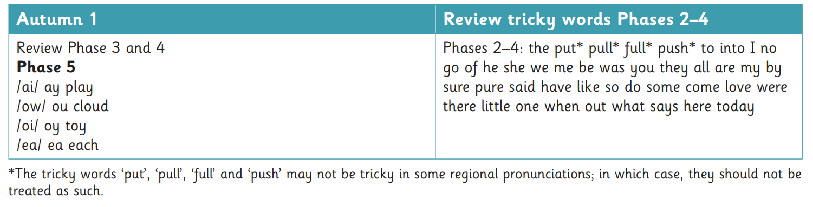
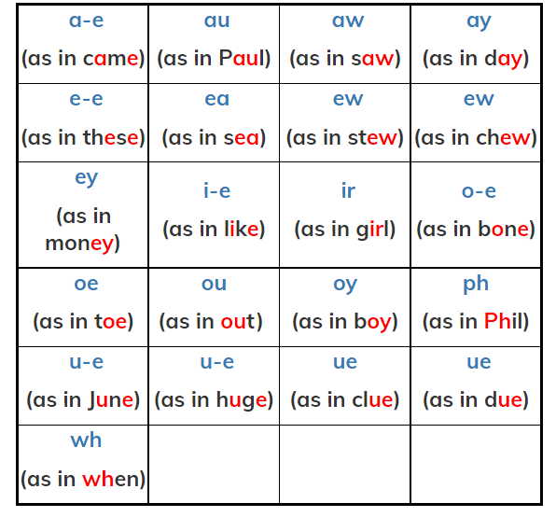
Year 1 Curriculum – Phonics
Little Wandle Letters and Sounds programme to continue

Slide 6


Year 1 Phonics Assessment – June 2023
-40 words (real and nonsense).
-A window in June to complete the assessments.
-Mrs Free to carry out assessments with QA from Mrs Horlor / Mrs Hamblin/ Mrs Jones.
Reported to the Government.
End of year report to parents.
Resit in Year 2

Slide 7
Year 1 Curriculum –Reading
Reading in Herons:
Three sessions a week in school (Miss Matthews and/or Miss Garrett)
Reading books and reading diaries in school everyday and please read at home at least 3 times per week to support fluency.
Reading practice book and library sharing book.
Never read to | Read to 1-2 times per week | Read to 3-5 times per week | Read to daily | Read 5 books a day
4,662 words | 63,570 words | 169,520 words | 296,660 words | 1,483,300 words
Taken from the DfE document ‘The reading framework Teaching the foundations of literacy July 2021’; based on research completed and published in Science Daily.

Slide 8

Year 1 Curriculum –Writing

Slide 9
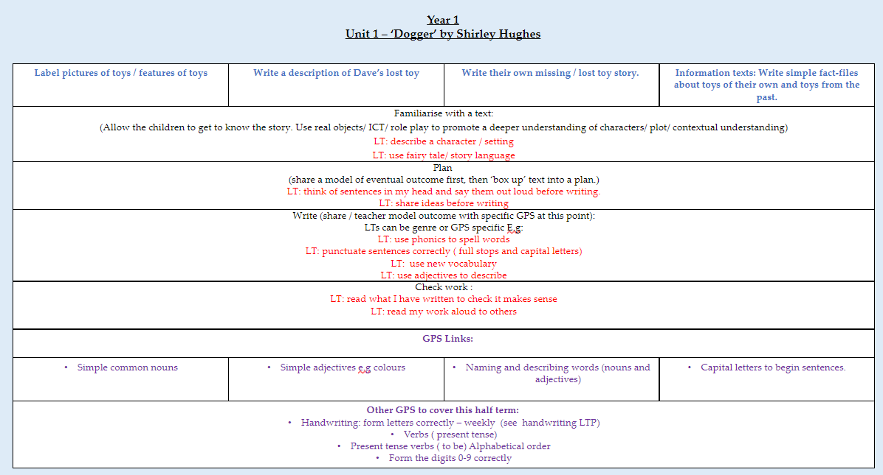

Slide 10
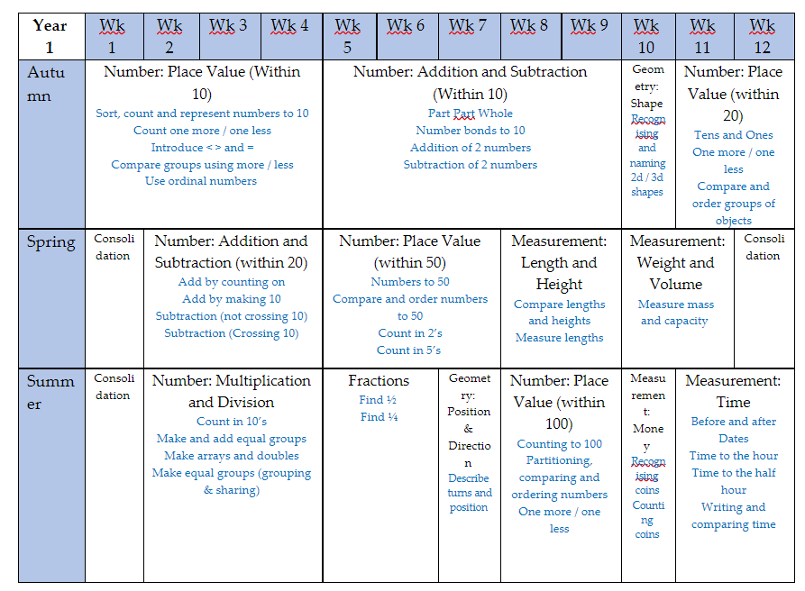

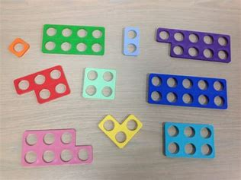
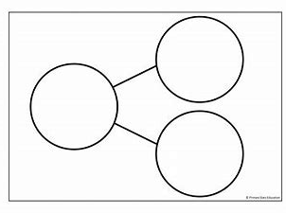
Mathematics

Slide 11
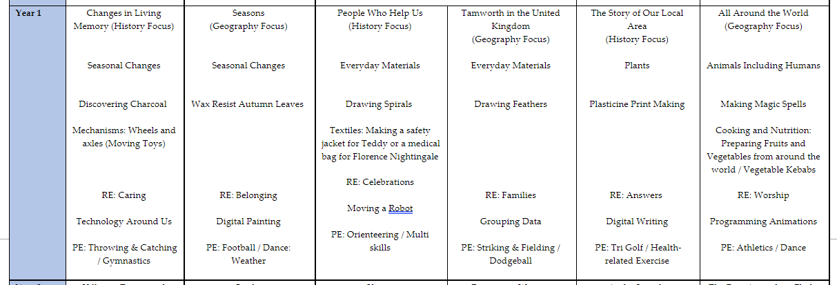
Year 1 Curriculum – Foundation Subjects

Slide 12
Year 1 Curriculum – Enrichment Opportunities
Continuation of learning opportunities e.g. Black History Month, Harvest, Reverend Sue, links with schools across the trust.
Trips / Visits process

Slide 13
The School Day (KS1)
8:45am – Doors Open (Enter via the Year 1 door – children complete early morning tasks and interventions)
8:55am – Year 1 door locked (enter through office)
9:00am – Register Taken
10:30am – 10:45am Morning Break
12:00pm – 1:00pm Lunch Time
3:30pm – Home Time (Gates will open at 3:15pm and children released to parent at 3:30pm)
NB. If somebody different is collecting please notify the office.
Attendance (letters / clinics), Punctuality and Holidays – Sam Lewis

Slide 14
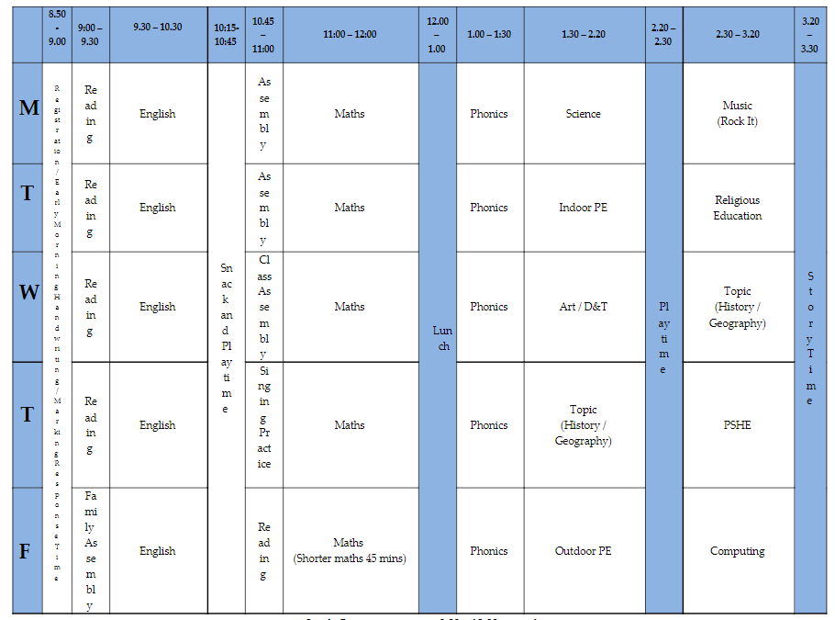

Slide 15
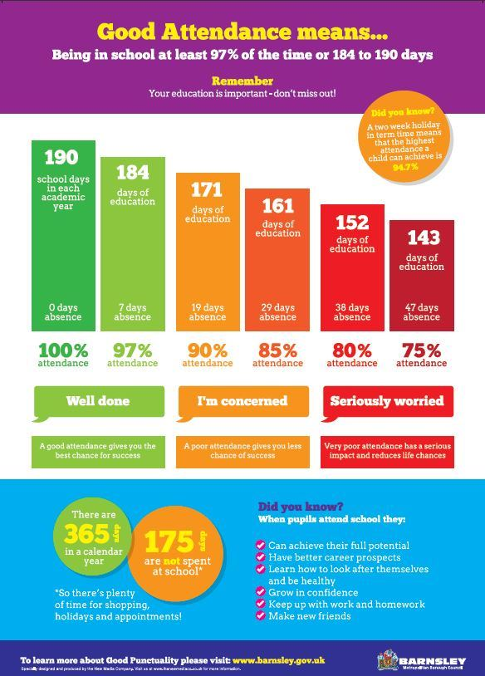
Attendance, Punctuality and Holidays – Sam Lewis

Slide 16
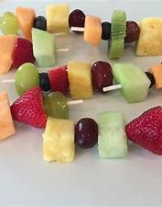
Snack and Lunch
Snacks can be booked and paid for through Parent Pay.
Offer will be the same as in EYFS (Pancakes, toast, fruit).
Own snack can be provided however must not contain chocolate, nuts or kiwi and must be healthy e.g:
-Fruit
-Cereal bar (not chocolate)
-Plain scotch pancake
-Fruit winders (or similar).
Please no yoghurts or crisps
Water Bottles in school everyday.
Lunch will continue as in EYFS.

Slide 17
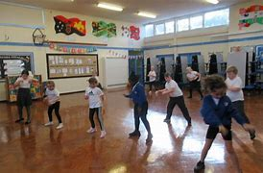
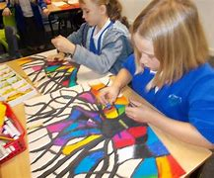

After school clubs
Monday – Art Club with Mrs Free
Thursday – Dance Club with Miss Matthews
Friday – Rock It Music Club
Starting w/c 12th September 3:30pm – 4:15pm
After October Half Term: Cooking, Football, Eco Club

Slide 18
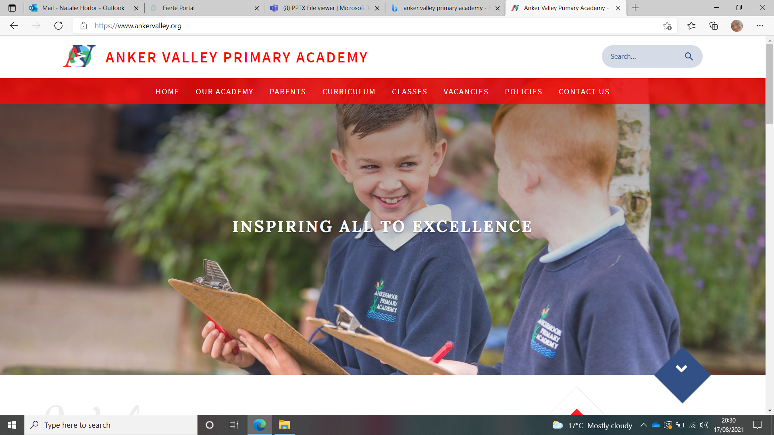

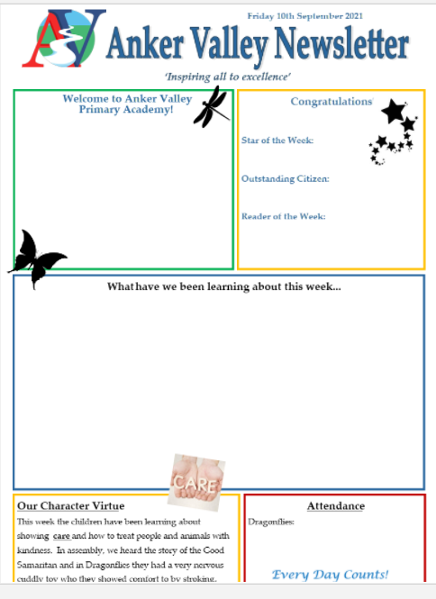

Website
-Term Dates
-Uniform (expectations)
-Copies of Newsletters
-Class Pages
Newsletter
-Emailed weekly
-Reminders of dates
-Learning that has taken place
-Stars of the week
Parents Evenings, Workshops, Assemblies, End of Year Reports.

Slide 19



Parent Portal
- Check Data held by school
-Receive newsletters and other letters
-View attendance
Parent Pay
-Payments for trips
-Dinner Money Payment
-Cashless
Tapestry (Year 1)
-Share children's achievements and learning experiences at home and in school
-Children will be able to upload their own learning in school.
-Homework to be set and submitted on Tapestry.

